Slide 1

PRESENTED BY GROUP 1
HOSPITAL MANAGEMENT SYSTEM
CVSU MEDICAL CENTER
ITEC - WEB SYSTEM AND TECHNOLOGIES

Slide 2

ABOUT THE PROJECT
This project is in charge of delivering basic medical services that are promotive, preventive, and curative. It aims to provide quality, affordable, and accessible medical services to its patients.

Slide 3
TARGET BENEFICIARIES
Patients
Professionals
Provide easy-to-use website design, and information for medical and services cost.
Benefit from information about the facilities and equipment to diagnose and treat patients effectively.
Researchers and Academics
Researchers and students utilize information for hospital facilities to conduct clinical trials and research studies.

Slide 4

SYSTEM MAIN DESIGN AND RESPONSIVENESS

Slide 5
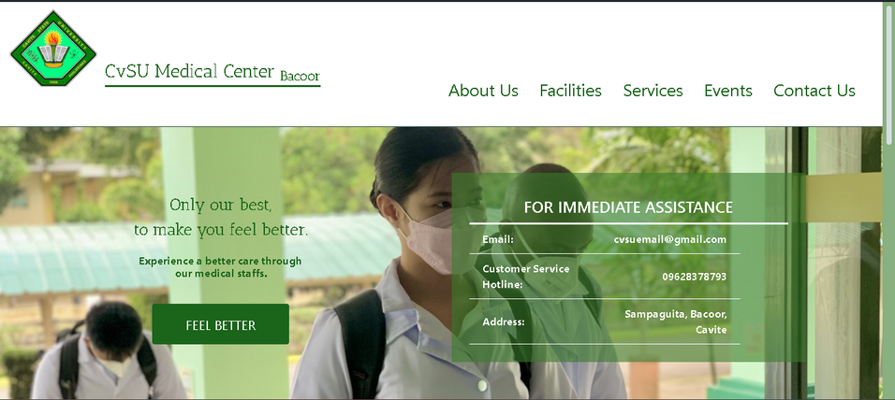
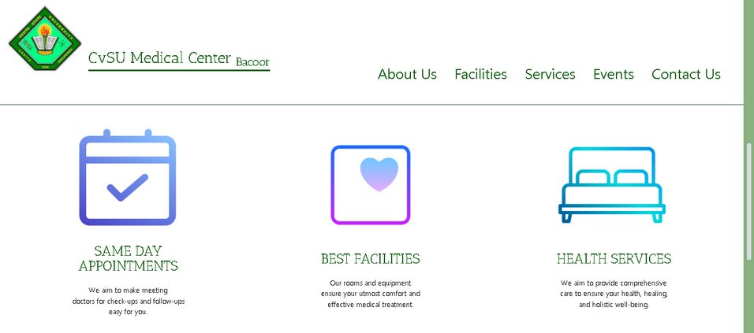

HEADER
The project Cavite State University Medical Center (CvSUMed) consists of a Header, Main Content, and Footer, and each option will take you to a different web page. The project is composed of “9” different options to click for a user-friendly system that simplifies tasks.
CONTENT
FOOTER

Slide 6
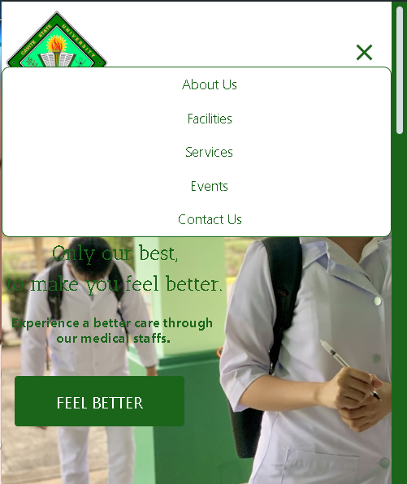
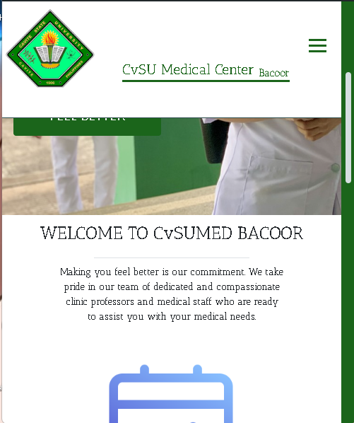
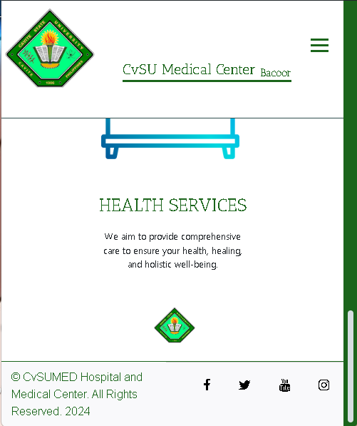
REPONSIVENESS
HEADER
CONTENT
FOOTER

Slide 7

PRESENTED BY GROUP 1
THANK YOU VERY MUCH!
CVSU MEDICAL CENTER - ITEC WEB SYSTEM AND TECHNOLOGIES

